Slide 1

CC 141 Discrete Structures Department of Computer Science School of Systems and Technology University of Management and Technology Lahore, Pakistan

Slide 2
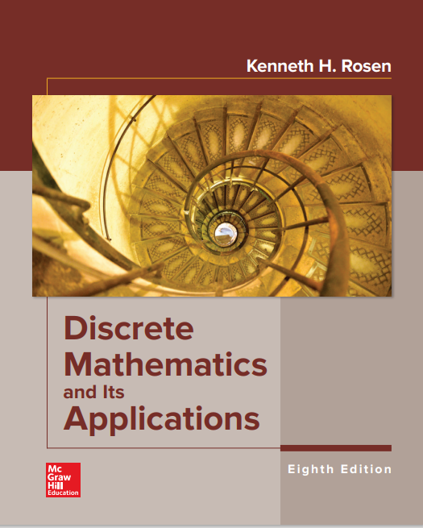
Books
Text Book
Reference Material
Discrete Mathematics and Its Applications by Kenneth H. Rosen (Latest Edition).
Discrete Mathematics with Applications by Susanna S. Epp
Discrete Mathematics by Richard Johnsonbaugh

Slide 3
Assessment Instruments with Weights
Assignments: 10%
Quizzes: 15%
Midterm Exam: 25%
Final Exam: 50%

Slide 4
Course Objectives & Learning Outcomes
At the end of the course the students will be able to:
Understand the key concepts of Discrete Structures such as Logic, Arguments, Sets, Permutations, Relations, Graphs, Trees etc.
Apply the concepts of Discrete Structures to solve real world problems and other computing problems
Analyze various discrete structures and their relevance within the context of computer science such as Graphs and Trees

Slide 5
Discrete Mathematics Topics
Propositional and predicate calculus
Proof methods
Set theory and functions
Sequences and summations
Growth of functions and complexity of algorithms,
Mathematical Induction
Basic counting techniques
Relations
Basic graph theory
Introduction to trees.

Slide 6
What is Discrete mathematics / structures?
The word discrete is essentially the opposite of continuous i.e. discontinuous or segregated.
Discrete Mathematics part of mathematics devoted to study of discrete objects.
Definition:
“Discrete Mathematics/Structure concerns processes that consist of a sequence of individual steps.”
It consists of distinct or unconnected elements.
Such as:
Integers
Set
Graphs etc.

Slide 7

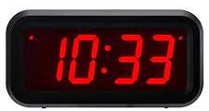
Discrete and Continuous
X(t)
Discrete / Digital
Continuous / Analog
t
Continuous Signals
Set of Real Numbers:
• • • • • • •
-3 -2 -1 0 1 2 3
X(t)
Set of Integers:
• • • • • •
3 -2 -1 0 1 2
t
Discrete Signals

Slide 8
Why Discrete Math?
Computers run software and store files. The software and files are both stored as huge strings of 1s and 0s. Binary math is discrete mathematics.
Used in proving correctness of a program.
Used in computer networks lots of topics about graph theory is used.
Google Maps uses discrete mathematics to determine fastest driving routes and times.
Artificial intelligence lots of ideas about logic is used.
Encryption and decryption are part of cryptography.

Slide 9
Importance of Discrete Mathematics
Gateway to more advanced CS courses
Data Structures
Introduction to Algorithms
Automata Theory
Compiler Construction
Operating Systems
Graph Theory
Artificial Intelligence Etc.

Slide 10
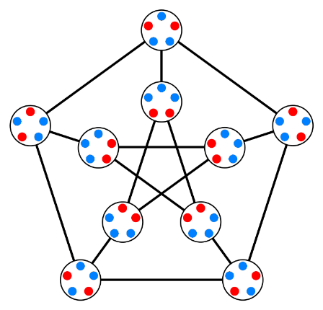
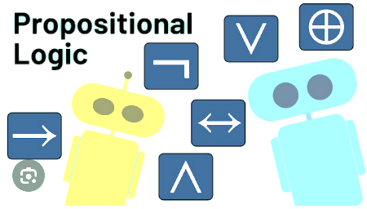
Propositional Logic Propositions, Logical Connectives, Negation, Converse, Contrapositive

Slide 11
Logic
“Logic is the study of the principles and methods that distinguishes between a valid and an invalid argument.”
Crucial for mathematical reasoning
Important for program design
Used for designing electronic circuitry
Logic is a system based on propositions.

Slide 12
Propositions
Definition:
A Proposition is a (declarative) statement whose value is either True or False but not both.
We say that the truth value of a proposition is either true (T) or false (F).
Corresponds to 1 and 0 in digital circuits
Note: Propositions are generally denoted by small letters p, q, r etc.

Slide 13
Propositions
Examples:
Sun is shining
2 + 2 = 7
Grass is blue.
The capital of Pakistan is Islamabad
I like to play Cricket

Slide 14
The Statement/Proposition Game
“Elephants are bigger than mice.”
Is this a declarative statement?
yes
Is this a proposition?
yes
What is the truth value of the proposition?
true

Slide 15
The Statement/Proposition Game
“520 < 111”
Is this a declarative statement?
yes
Is this a proposition?
yes
What is the truth value
of the proposition?
false

Slide 16
The Statement/Proposition Game
“y > 5”
Is this a declarative statement?
yes
Is this a proposition?
no
Its truth value depends on the value of y, but this value is not specified.
We call this type of statement a propositional function or open sentence.

Slide 17
The Statement/Proposition Game
“Today is March, 2025 and 99 < 5.”
Is this a declarative statement?
yes
Is this a proposition?
yes
What is the truth value of the proposition?
false

Slide 18
The Statement/Proposition Game
“Please do not fall asleep.”
Is this a declarative statement?
no
It’s a request.
Is this a proposition?
no
Only declarative statements can be propositions.

Slide 19
The Statement/Proposition Game
“What is your name?”
Is this a declarative statement?
no
It’s a question / interrogation
Is this a proposition?
no
Only declarative statements can be propositions.

Slide 20
The Statement/Proposition Game
“C++ is the best language”
Is this a declarative statement?
yes
Is this a proposition?
no
It’s an opinion.
No opinion is a proposition.

Slide 21
The Statement/Proposition Game
“x < y if and only if y > x.”
Is this a declarative statement?
yes
Is this a proposition?
yes
… because its truth value does not depend on specific values of x and y.
What is the truth value
of the proposition?
true

Slide 22
Compound Proposition

Slide 23
Compound Proposition: Logical Connectives
Compound proposition are obtained the use of logical connectives.
Logical Connectives include:
Negation … (denoted by ! or ¬)
And … (denoted by ∧). It is called Logical Conjunction.
Or … (denoted by ∨). It is called Logical Disjunction.
Exclusive OR … (denoted by ⊕)
Implication … (denoted by →)
Biconditional … (denoted by ↔)

Slide 24
Compound Proposition: Examples
The weather of Murree is not very pleasant
It is a sunny day outside but children are not playing in the parks.
Either the students are playing Cricket or the teachers are gossiping.
Either it is day or it is night but not both
My students are very honest and hard-working
If you secure A grade then I will buy you a new bike.
Ali goes to school if and only if his father drops him there.

Slide 25
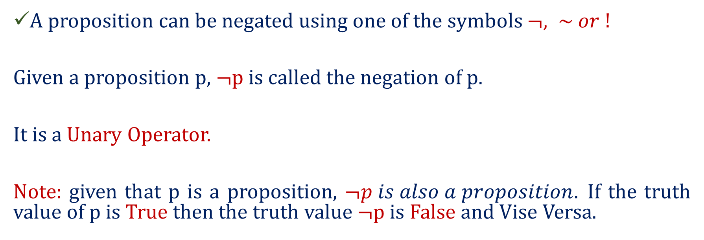
Compound Propositions… Negation
A proposition can be negated using one of the symbols $¬, \sim or !$
Given a proposition p, $¬$p is called the negation of p.
It is a Unary Operator.
Note: given that p is a proposition, $¬p is also a proposition.$If the truth value of p is True then the truth value $¬$p is False and Vise Versa.
P | ¬ P
true (T) | false (F)
false (F) | true (T)

Slide 26
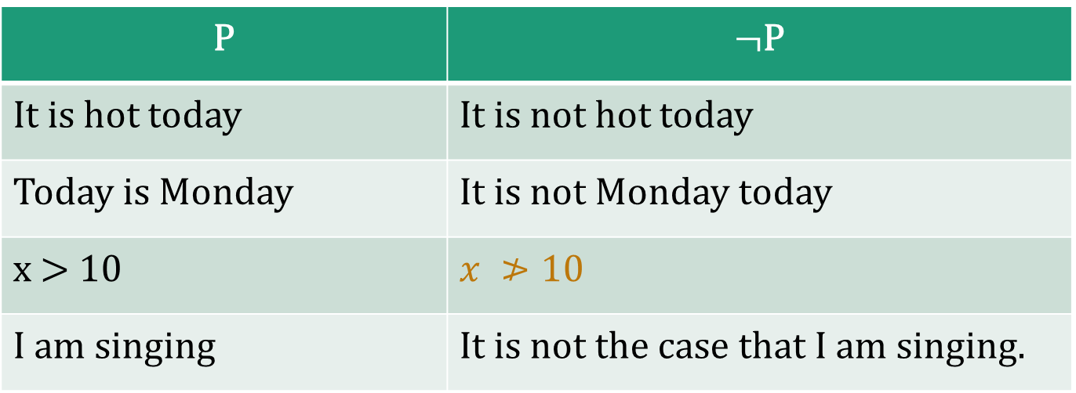
Logical Connectives … Negation … Examples
P | $¬$P
It is hot today | It is not hot today
Today is Monday | It is not Monday today
x > 10 | $$x ≯10$$
I am singing | It is not the case that I am singing.

Slide 27
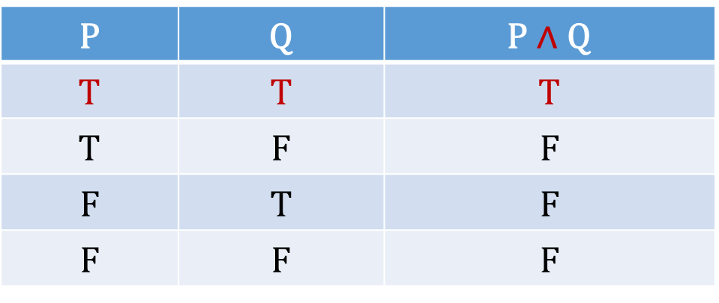
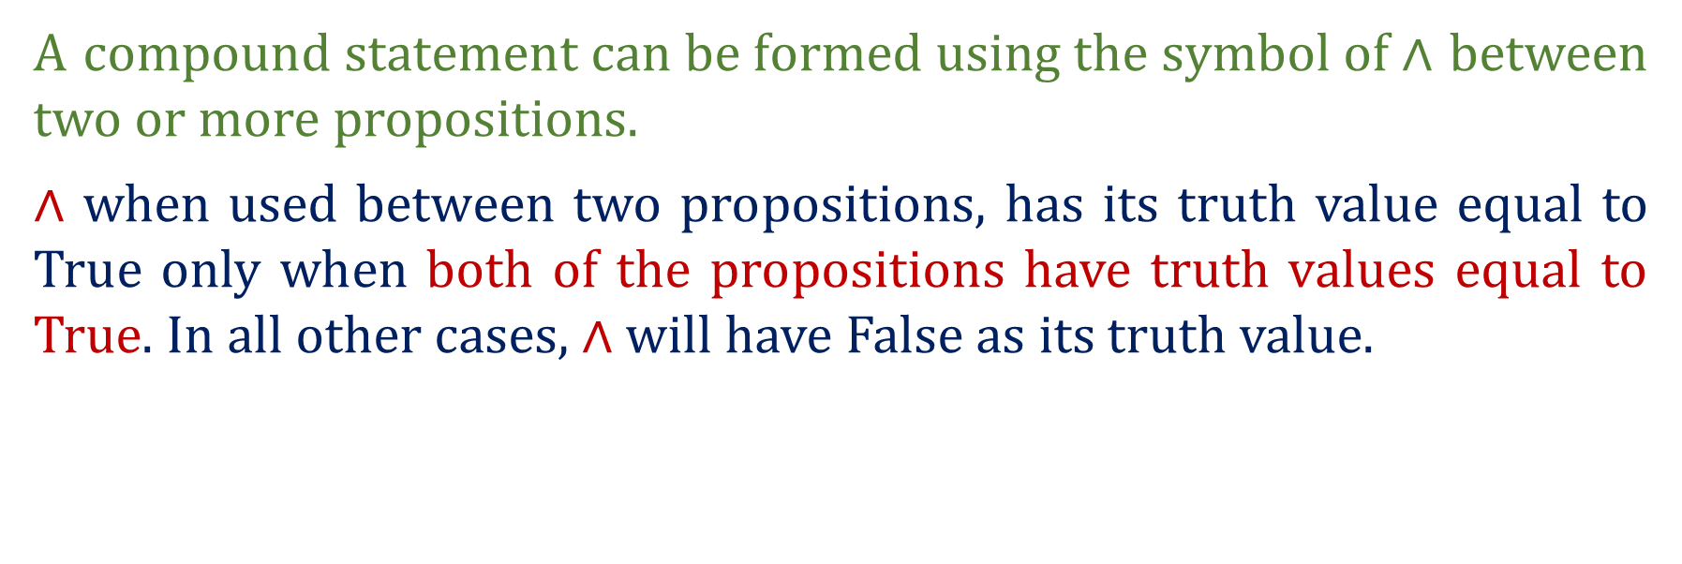
Compound Propositions… Conjunction ∧
A $compound statement can be formed using the symbol of \text{∧}$ between two or more propositions.
$\text{∧}$ when used between two propositions, has its truth value equal to True only when both of the propositions have truth values equal to True. In all other cases, $\text{∧}$ will have False as its truth value.
P | Q | P $\text{∧}$ Q
T | T | T
T | F | F
F | T | F
F | F | F

Slide 28
Compound Propositions… Conjunction ∧
P | Q | P ∧ Q
2 + 5 = 6 | It is raining | 2 + 5 = 6 AND it is raining.
Ali is punctual | Ali is regular | Ali is both punctual and regular.
Sara is smart | Sara is intelligent | Sara is both smart as well as intelligent.
Lahore is hot in summer | Lahore is dusty in summer. | In summer, Lahore is hot and dusty.

Slide 29
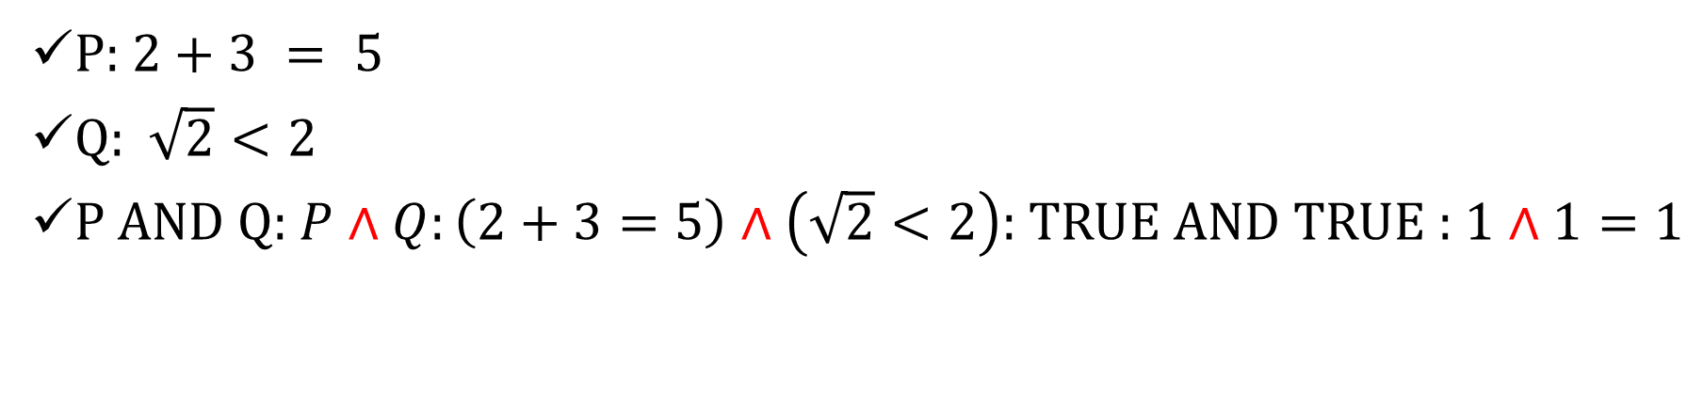
Logical AND
P: $2+3 = 5$
Q: $\sqrt{2}<2$
P AND Q: $P∧Q:\left(2+3=5\right)∧\left(\sqrt{2}<2\right)$: TRUE AND TRUE : $1∧1=1$

Slide 30

Compound Propositions… Conjunction ∧
$\text{∧}$ when used between more than two propositions has its truth value equal to True only when all of the propositions have truth values equal to True. In all other cases, $\text{∧}$ will have False as its truth value.
A | B | C | D | E | …. | A ∧ B ∧ C ∧ D…
T | T | T | T | T | …. | T
T/F | T/F | T/F | T/F | T/F | …. | F
T/F | T/F | T/F | T/F | T/F | …. | F
T/F | T/F | T/F | T/F | T/F | …. | F
…. | …. | …. | …. | …. | …. | F
F | F | F | F | F | …. | F

Slide 31

Logical AND
$For any proposition P, P∧¬P=0 (False)$
If we have number of propositions $p_{1},p_{2}, p_{3}, ⋯, p_{n}$ …. If any of these statements is FASLE, then whole CONJUNCTION is FASLE
$$p_{1}∧p_{2}∧p_{3}∧⋯∧p_{n}=False$$

Slide 32
Logical AND Truth Table
Binary Operator, Symbol: ∧
P | Q | P∧ Q
T | T | T
T | F | F
F | T | F
F | F | F

Slide 33
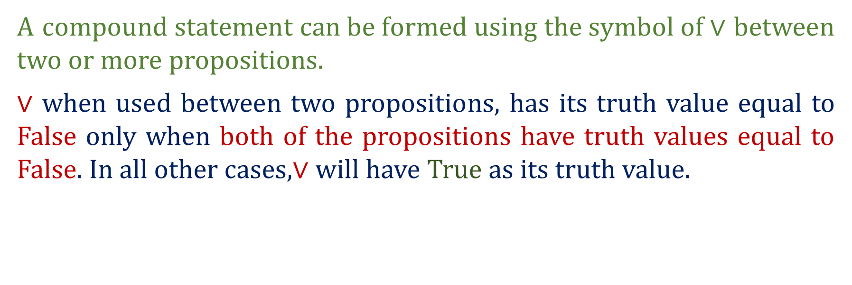
Compound Propositions… Disjunction ∨
A$compound statement can be formed using the symbol of∨$between two or more propositions.
∨ when used between two propositions, has its truth value equal to False only when both of the propositions have truth values equal to False. In all other cases,∨ will have True as its truth value.
P | Q | P ∨ Q
T | T | T
T | F | T
F | T | T
F | F | F

Slide 34
Compound Propositions… Disjunction ∨
P | Q | P ∨ Q
2 + 5 = 6 | It is raining | 2 + 5 = 6 or it is raining.
Ali is punctual | Ali is regular | Ali is either punctual or regular.
Sara is smart | Sara is intelligent | Sara is smart or she is intelligent.
Lahore is hot in summer | Lahore is dusty in summer. | In summer, Lahore is hot or dusty.

Slide 35

Logical OR
P: $2+3 =6$
Q: $\sqrt{2}>2$
P OR Q: $P \text{∨} Q:\left(2+3=6\right) \text{∨} \left(\sqrt{2}>2\right)$: False OR False : 0 $\text{∨} 0=0$

Slide 36

Compound Propositions… Disjunction ∨
∨ when used between more than two propositions has its truth value equal to False only when all of the propositions have truth values equal to False. In all other cases, $\text{∧}$ will have True as its truth value.
A | B | C | D | E | …. | A ∨ B ∨ C ∨ D…
T | T | T | T | T | …. | T
T/F | T/F | T/F | T/F | T/F | …. | T
T/F | T/F | T/F | T/F | T/F | …. | T
T/F | T/F | T/F | T/F | T/F | …. | T
…. | …. | …. | …. | …. | …. | T
F | F | F | F | F | …. | F

Slide 37

Logical OR
$For any proposition P, P\text{∨}¬P=1 (True)$
If we have number of propositions $p_{1},p_{2}, p_{3}, ⋯, p_{n}$ …. If any of these statements is True, then whole DISJUNCTION is True
$$p_{1}\text{∨} p_{2} \text{∨} p_{3} \text{∨}⋯ \text{∨} p_{n}=True$$

Slide 38
Logical OR Truth Table
Binary Operator, Symbol: ∨
P | Q | P ∨ Q
T | T | T
T | F | T
F | T | T
F | F | F

Slide 39
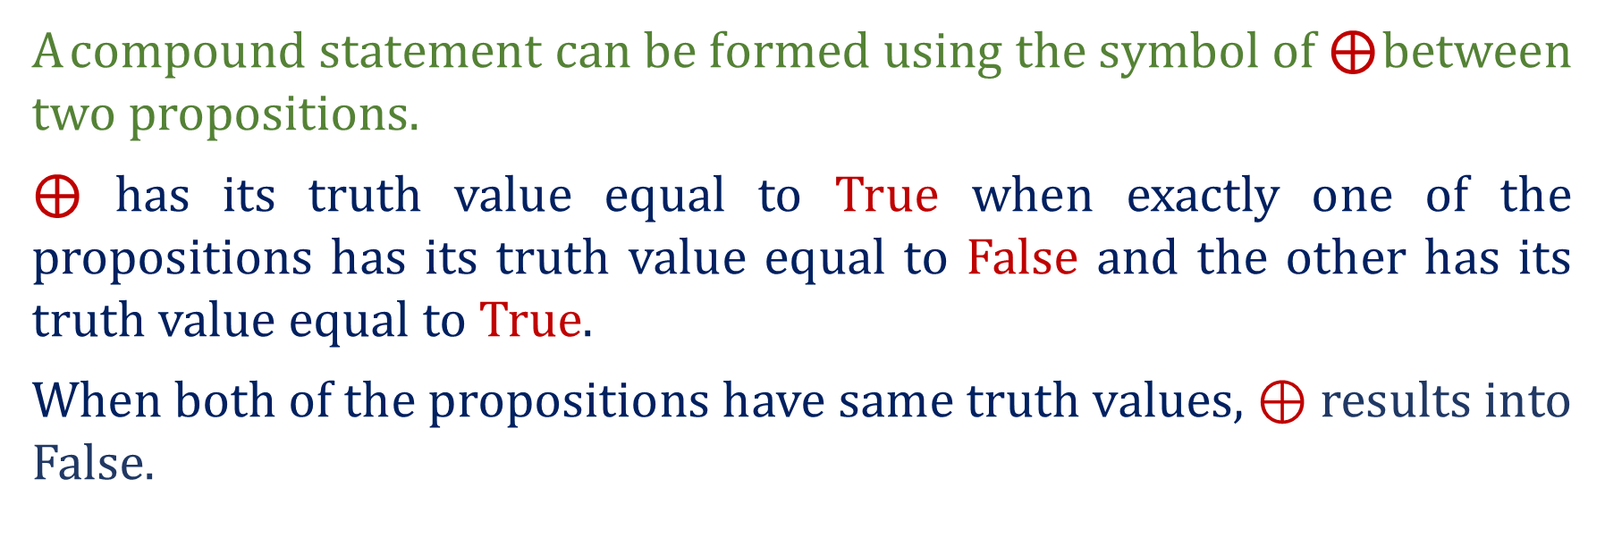
Compound Propositions… XOR ⊕
A$compound statement can be formed using the symbol of \text{⊕}$between two propositions.
⊕ has its truth value equal to True when exactly one of the propositions has its truth value equal to False and the other has its truth value equal to True.
When both of the propositions have same truth values, ⊕ results into False.
P | Q | P ⊕ Q
T | T | F
T | F | T
F | T | T
F | F | F

Slide 40
Compound Propositions… XOR ⊕
P | Q | P ⊕ Q
2 + 5 = 6 | It is raining | Either 2 + 5 = 6 or it is raining but not both
Ali is punctual | Ali is regular | Ali is either punctual or regular but not both.
Sara is smart | Sara is intelligent | Sara is either smart or she is intelligent both not both.
Lahore is hot in summer | Lahore is dusty in summer. | In summer, Lahore is either hot or dusty but not both.

Slide 41
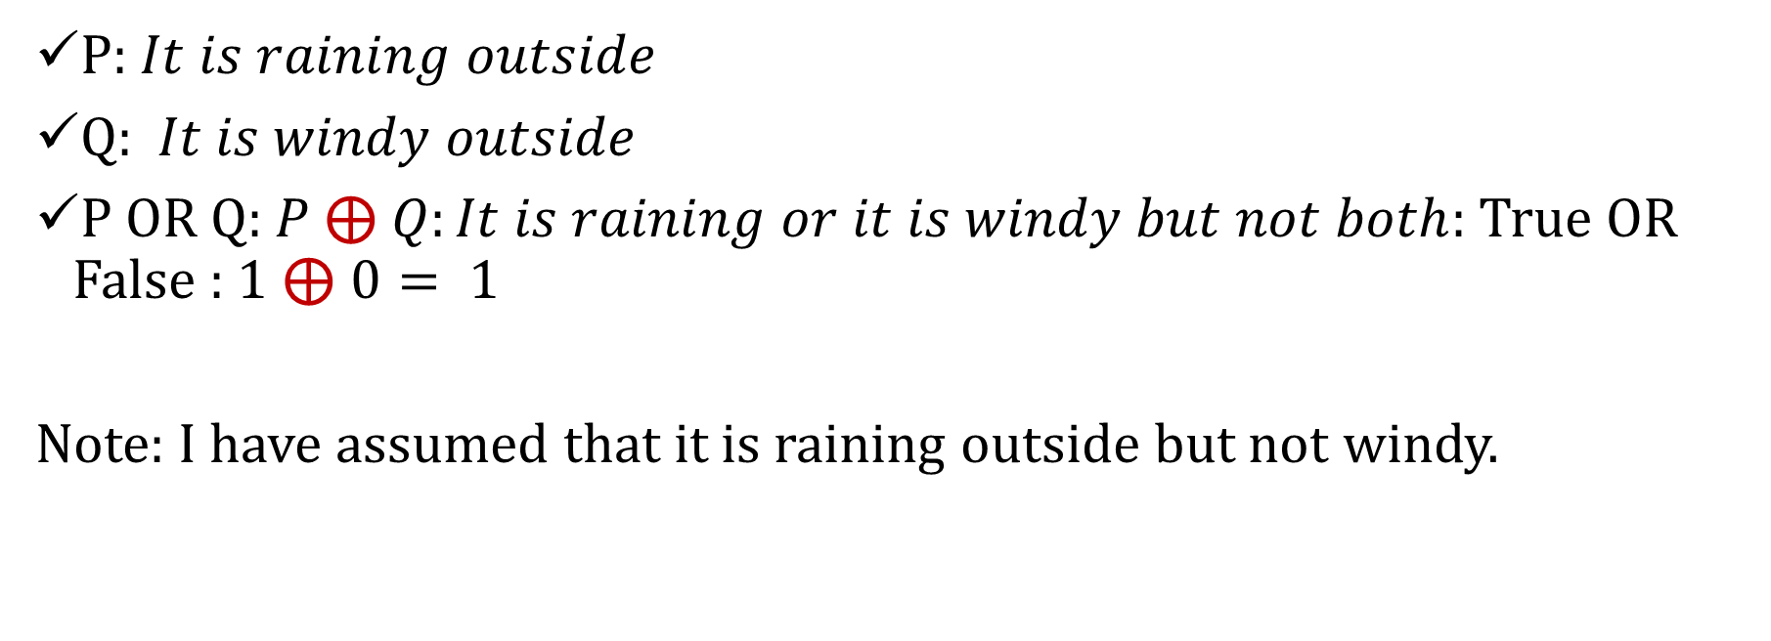
Logical XOR
P: $It is raining outside$
Q: $It is windy outside$
P OR Q: $P \text{⊕} Q:It is raining or it is windy but not both$: True OR False : 1 ⊕$0= 1$
Note: I have assumed that it is raining outside but not windy.

Slide 42
Logical XOR Truth Table
Binary Operator, Symbol: ⊕
P | Q | P⊕Q
T | T | F
T | F | T
F | T | T
F | F | F

Slide 43
XOR: Examples
You can either win the match or lose the match but not both
You can either Pass this course or fail this course but not both
If A.B < 0 implies that either A < 0 or B < 0 but not both

Slide 44
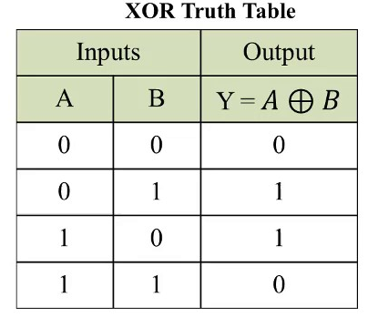
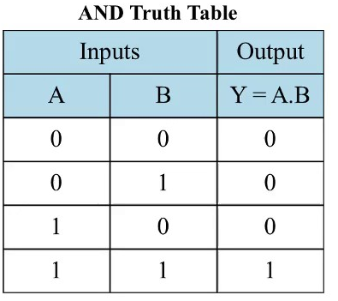
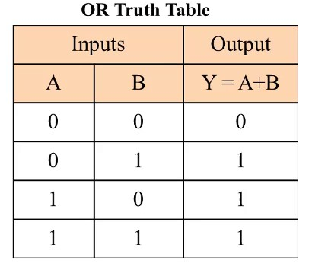

Slide 45
Exercises … for students …
p = “Islamabad is the capital of Pakistan”
q = “17 is divisible by 3”
p ∧ q =
p ∨ q =
~p =
“Islamabad is the capital of Pakistan and 17 is divisible by 3”
“Islamabad is the capital of Pakistan or 17 is divisible by 3”
“It is not the case that Islamabad is the capital of Pakistan” or simply “Islamabad is not the capital of Pakistan”

Slide 46
Translating from English to Symbols:
Exercises … for students …
Let p = “It is hot”, and q = “It is sunny”
SENTENCE
It is not hot.
It is hot and sunny.
It is hot or sunny.
It is not hot but sunny.
It is neither hot nor sunny.
SYMBOLIC FORM
~ p
p ∧ q
p ∨ q
~ p ∧ q
~ p ∧ ~ q

Slide 47
Translating from Symbols to English
Exercises … for students …
Let m = “Ali is good in Mathematics”
c = “Ali is a Computer Science student”
SYMBOLIC FORM STATEMENTS
~ c
c ∨ m
m ∧ ~c
Ali is not a Computer Science student
Ali is a Computer Science student or good in Math's
Ali is good in Math's but not a Computer Science student

Slide 48
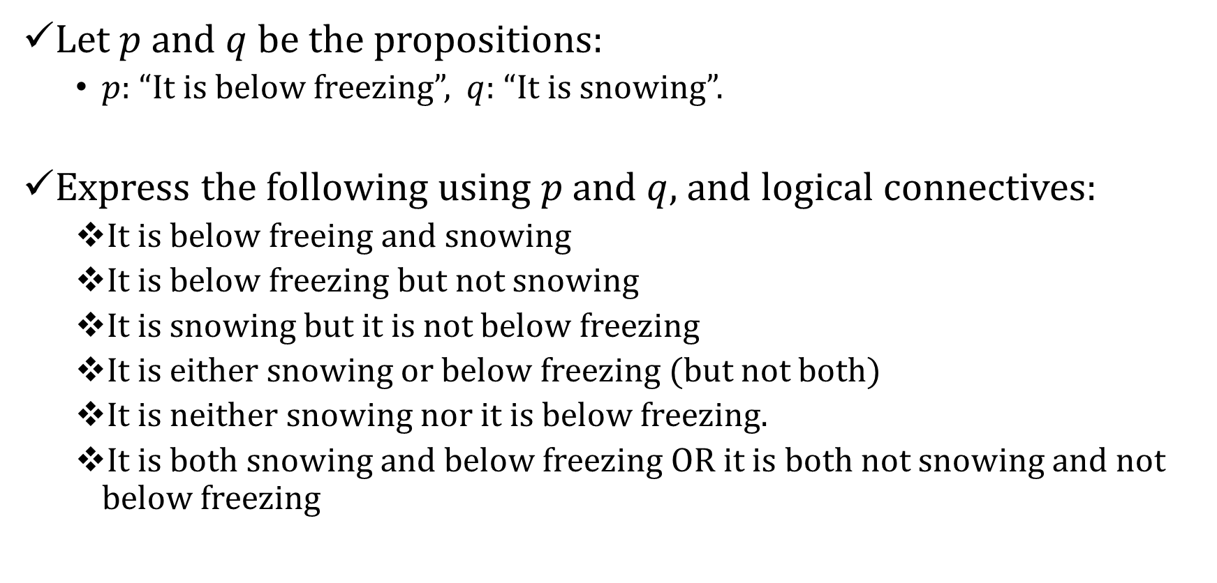
Exercises … for students …
Let $p$ and $q$ be the propositions:
$p:$ “It is below freezing”, $q:$ “It is snowing”.
Express the following using $p$ and $q$, and logical connectives:
It is below freeing and snowing
It is below freezing but not snowing
It is snowing but it is not below freezing
It is either snowing or below freezing (but not both)
It is neither snowing nor it is below freezing.
It is both snowing and below freezing OR it is both not snowing and not below freezing

Slide 49
Implications (Conditional Statement)
Let p and q be two propositions then the implication statement i.e., p → q is a proposition whose value is False only when p is True and q is False. Its value is True otherwise.
Here p is called hypothesis (or premise) and q is called conclusion (or consequence).

Slide 50
Conditional Statement …. Truth Table
Binary Operator, Symbol: →
P | Q | P→Q
T | T | T
T | F | F
F | T | T
F | F | T

Slide 51
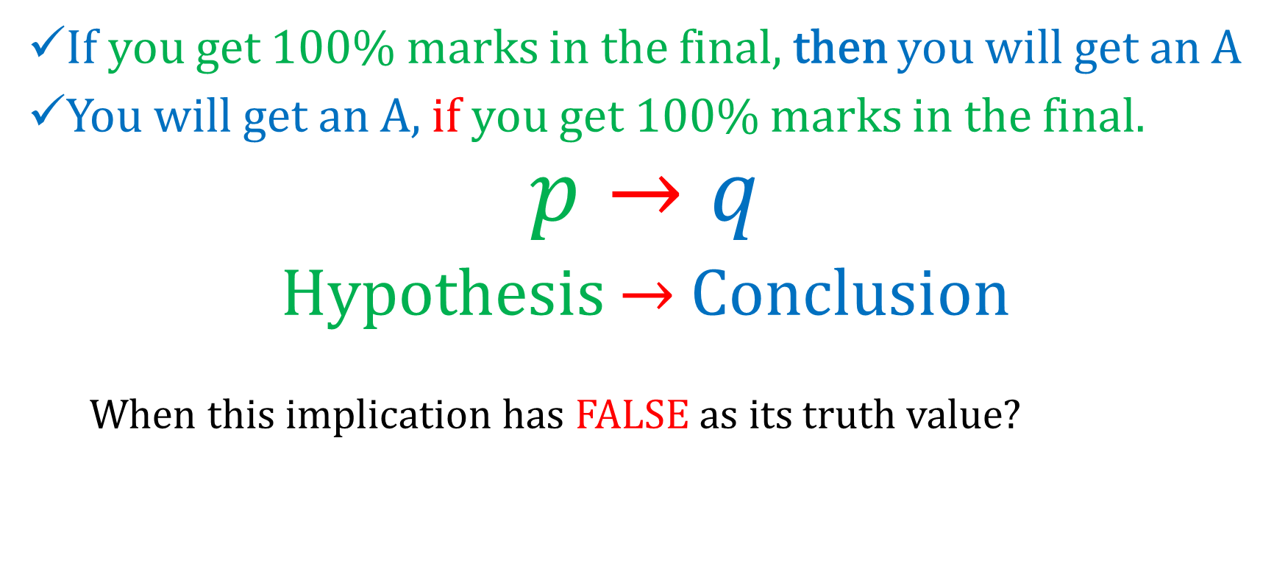
Implication: an example
If you get 100% marks in the final, then you will get an A
You will get an A, if you get 100% marks in the final.
$$p→q$$
Hypothesis $→$ Conclusion
When this implication has FALSE as its truth value?

Slide 52
Implication: An Example
If you get 100% marks in the final, then you will get an A.
When does the above implication has FALSE as its truth value?
Think of an implication as the promise that if P happen, then Q will definitely happen.
It is FALSE if P happens and Q does not happen (the promise has been broken)
In any other case, the promise is not broken, and the implication is TRUE.

Slide 53
Implication … Examples
If you buy a train ticket early, it is cheaper.
If you get good wage, you dress up well.
If x is a real number, x² ≥ 0.
If it rains, grass gets wet.
If 1 = 1, then 3 = 3.

Slide 54
Ways of Expressing Implications
The implication p → q could be expressed in many alternative ways as:
“if p, then q”
“p implies q”
“if p, q”
“p only if q”
“p is sufficient for q”
“a sufficient condition for q is p”
“q if p” “
q whenever p”
“q when p”
“q is necessary for p”
“a necessary condition for p is q”
“q follows from p”
“q unless p”
“q provided that p”

Slide 55
EXAMPLE
P = Maria learns discrete mathematics
Q = Maria will find a good job
if p then q | If Maria learns discrete mathematics then she will find a good job.
p implies q | Maria learns discrete mathematics implies she will find a good job.
if p, q | If Maria learns discrete mathematics, she will find a good job.
p only if q | Maria learns discrete mathematics only if she will find a good job.
p is sufficient for q | Maria learns discrete mathematics is sufficient for she will find a good job.
q unless p | Maria will find a good job unless she learns discrete mathematics.
q if p | Maria will find a good job if she learns discrete mathematics.
q is necessary for p | Maria will find a good job is necessary for she learns discrete mathematics.

Slide 56
Exercises
You can access the Internet from campus only if you are a computer science major or you are not a freshman.
P: You can access the Internet from campus
Q: you are a computer science major
R: you are a freshman
P → (Q ∨ ¬R)

Slide 57
Exercises
School is closed if more than 2 feet of snow falls or if the wind chill is below -100.
P: School is closed
Q: 2 feet of snow falls
R: wind chill is below -100
Q ∨ R → P

Slide 58
Implications … Exercises
What are the truth values of the following implications?
If sin x = 0, x = 0
If x² > 0, x > 0
If x³ > 0, x > 0
If Joe is the winner candidate, he must have secured more votes than other candidates.
If -3 is a positive number, 2 + 4 = 10

Slide 59
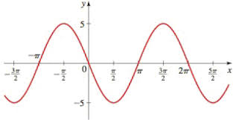
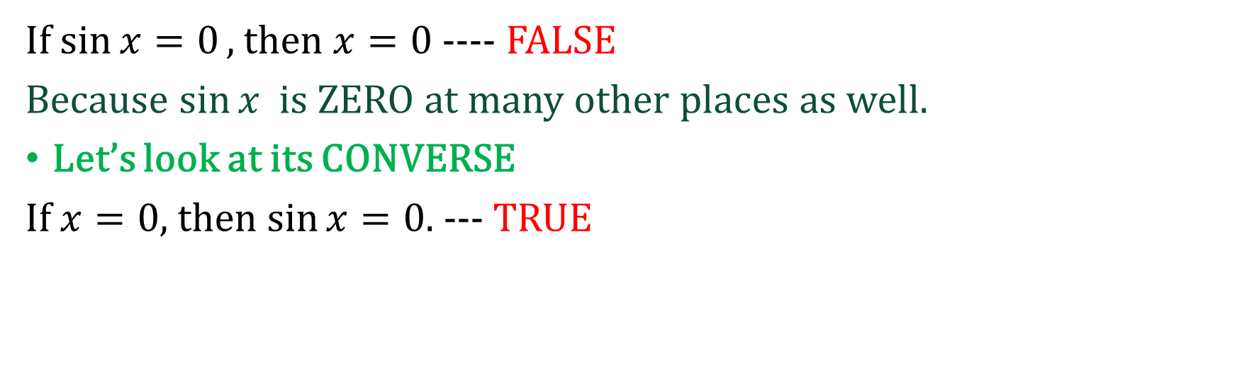
Exercise
If $\sin{x=0},$then $x=0$ ---- FALSE
Because $\sin{x }$ is ZERO at many other places as well.
Let’s look at its CONVERSE
If $x=0$, then $\sin{x=0}$. --- TRUE

Slide 60
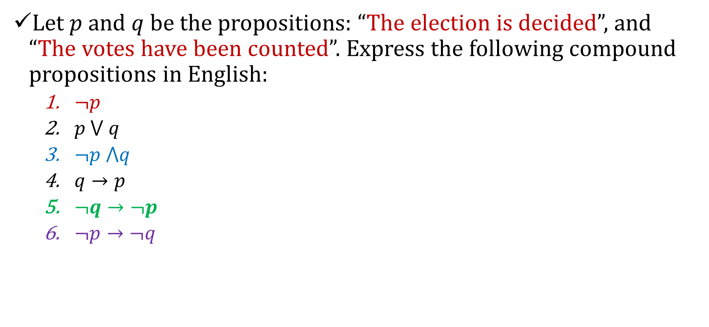
Do it by yourself
Let $p$ and $q$ be the propositions: “The election is decided”, and “The votes have been counted”. Express the following compound propositions in English:
$¬p$
$p ⋁ q$
$¬p ⋀q$
$q→p$
$¬q→¬p$
$¬p→¬q$

Slide 61
Converse
The proposition
q → p
is called the converse of
p → q
Note that
q → p !≡ p → q

Slide 62
Converse
“If it is raining, then the home team wins.”
The converse is
“If the home team wins, then it is raining.”

Slide 63
q → p !≡ p → q
p | q | p → q | q → p
T | T
T | F
F | T
F | F
T
F
T
T
T
T
F
T
F | T
T | F

Slide 64
Contrapositive
The proposition
￢q →￢p
is called the contrapositive of
p → q
Note that
￢q →￢p ≡ p → q

Slide 65
Contrapositive
“If it is raining, then the home team wins.”
The contrapositive is
“If the home team does not win, then it is not raining.”

Slide 66
￢q →￢p ≡ p → q
p | q | p → q | ￢p | ￢q | ￢q →￢p
T | T |  | F | F
T | F |  | F | T
F | T |  | T | F
F | F |  | T | T
T
F
T
T
T
F
T
T

Slide 67
￢q →￢p ≡ p → q
p | q | p → q | ￢p | ￢q | ￢q →￢p
T | T | T | F | F | T
T | F | F | F | T | F
F | T | T | T | F | T
F | F | T | T | T | T

Slide 68
Inverse
The proposition
￢p →￢q
is called the inverse of
p → q
Note that
￢p →￢q !≡ p → q

Slide 69
Inverse
“If it is raining, then the home team wins.”
The inverse is
“If it is not raining, then the home team does not win.”

Slide 70
￢p →￢q !≡ p → q
p | q | p → q | ￢p | ￢q | ￢p →￢q
T | T | T | F | F
T | F | F | F | T
F | T | T | T | F
F | F | T | T | T
T
T
F
T

Slide 71
￢p →￢q !≡ p → q
p | q | p → q | ￢p | ￢q | ￢p →￢q
T | T | T | F | F | T
T | F | F | F | T | T
F | T | T | T | F | F
F | F | T | T | T | T
p | q | p → q | ￢p | ￢q | ￢p →￢q
T | T | T | F | F | T
T | F | F | F | T | T
F | T | T | T | F | F
F | F | T | T | T | T
p | q | p → q | ￢p | ￢q | ￢p →￢q
T | T | T | F | F | T
T | F | F | F | T | T
F | T | T | T | F | F
F | F | T | T | T | T

Slide 72
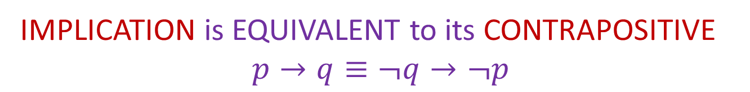
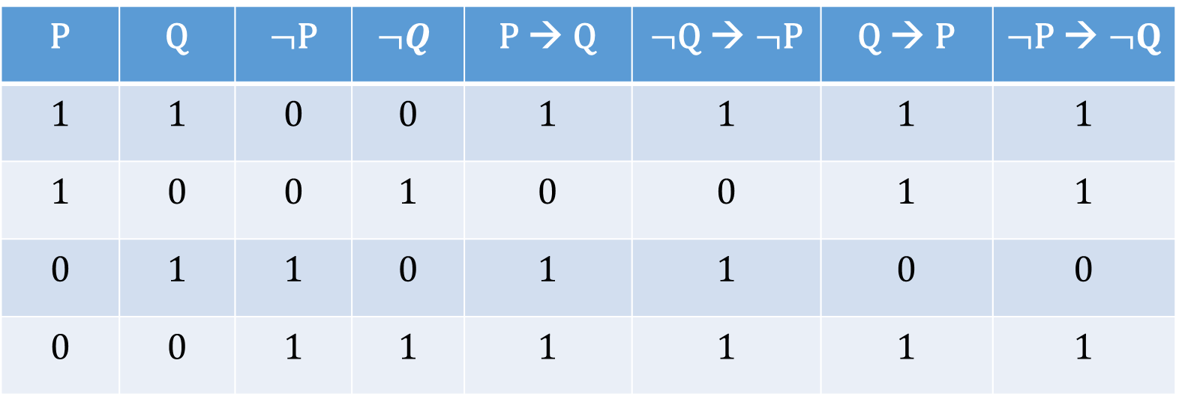
Implication, Converse, Inverse and Contraposition
P | Q | $¬$P | $$¬Q$$ | P → Q | $¬$Q → $¬$P | Q → P | $¬$P → $¬Q$
1 | 1 | 0 | 0 | 1 | 1 | 1 | 1
1 | 0 | 0 | 1 | 0 | 0 | 1 | 1
0 | 1 | 1 | 0 | 1 | 1 | 0 | 0
0 | 0 | 1 | 1 | 1 | 1 | 1 | 1
IMPLICATION is EQUIVALENT to its CONTRAPOSITIVE
$$p→q≡¬q→¬p$$

Slide 73
Exercise: Correct or Incorrect
TRUE

Slide 74
Exercise: Correct or Incorrect
False

Slide 75
Exercise: Correct or Incorrect
False

Slide 76
Exercise: Correct or Incorrect
true

Slide 77
Exercise: Correct or Incorrect

Slide 78
Bi-conditional Proposition
Given the two propositions P and Q, the biconditional ↔ is a proposition whose truth value is True when both P and Q have same truth values. It is False otherwise.
Note: biconditional is equivalent to (P → Q) ∧ (Q → P)
Biconditional is represented as if and only if or iff.

Slide 79
Biconditional (Bi-implications) (if and only if)
Binary Operator, Symbol: ↔
P | Q | P↔Q
T | T | T
T | F | F
F | T | F
F | F | T

Slide 80
Biconditional Statement
What does the following line mean?
You can take the flight if and only if you buy a ticket.
It means that
If you take the flight, then you have bought ticket,
AND,
if you buy ticket then you take the flight

Slide 81
Biconditional Statement … Truth Values
What are the truth values of the following biconditional statements?
If x² + y² = 0 if and only if x = 0 and y =0.
If 2 + 2 = 4 iff SQRT(2) < 2
33 is divisible by 4 if and only if horse has four legs.
If x³ ≥ 0 if and only if x ≥ 0
Sky is blue iff 1 = 0
TRUE
TRUE
FALSE
TRUE
FALSE

Slide 82
REPHRASING BICONDITIONAL
p↔q is also expressed as:
p is necessary and sufficient for q
If p then q, and conversely
p is equivalent to q
p exactly when q

Slide 83
Constructing Truth Tables

Slide 84
Precedence of Logical Operators
p ∧ q ∨ r means (p ∧ q) ∨ r
p ∨ q → r is the same as (p ∨ q) → r
Operator | Precedence
¬ | 1
∧ | 2
∨ | 3
→ | 4
↔ | 5

Slide 85
Constructing the Truth Tables
Statements and operators can be combined to form new statements.
P | Q | P∧Q | ¬(P∧Q) | (¬P)∨(¬Q)
T | T
T | F
F | T
F | F
T
F
F
F
F
T
T
T
F
T
T
T

Slide 86
Constructing the Truth Tables
Exercise : Construct Truth Table for : (p ∨ ¬q) → (p ∧ q)
P | Q | ¬Q | P ∨ ¬Q | P∧Q | (P ∨ ¬Q) → (P ∧ Q)
T | T | F | T | T | T
T | F | T | T | F | F
F | T | F | F | F | T
F | F | T | T | F | F

Slide 87
Logical Bit Operations 00000110011

Slide 88
Logic and Bit Operations
Truth Value | Bit
T | 1
F | 0
Computers represents information using bits.
A bit is a symbol with two possible values, namely,
0 (zero) and 1 (one).
This meaning of the word bit comes from binary digit.
Information is often represented using bit strings,
which are lists of zeros and ones.
The length of this string is the number of bits in the string.
101010011 is a bit string of length nine.
P | Q | P∧Q | P∨Q | P⊕Q
1 | 1 | 1 | 1 | 0
1 | 0 | 0 | 1 | 1
0 | 1 | 0 | 1 | 1
0 | 0 | 0 | 0 | 0

Slide 89
Exercises
Find the bitwise OR, bitwise AND, and bitwise XOR of the bit strings 01 1011 0110 and 11 0001 1101
01 1011 0110
11 0001 1101
11 1011 1111 bitwise OR
01 0001 0100 bitwise AND
10 1010 1011 bitwise XOR
Note: bit strings is splited into blocks of four bits to make them easier to read.

Slide 90

Summary
Chapter 1 : The Foundations: Logic and Proofs
1.1 Propositional Logic
Statement, Proposition, Truth value
Propositional symbol, Open proposition
Compound Propositions
Operators
Conditional statements
Converse, Inverse and contrapositive
Truth tables of compound propositions
Precedence of logical operators
Logic and bit operation
1.2 Application of Propositional Logic
Translating English Statement

